Slide 1


Team 42: Multi-Axis Cobot for Factory Automation Proof-of-Concept
Bi-Weekly Update 5 Emily Hamsa, Ethan Woods, Adrian Guzman, Jaishil Shah
Sponsor: Will Hofstetter
TA: Vishwam Raval
Notes:
Intro should take 30 seconds

Slide 2

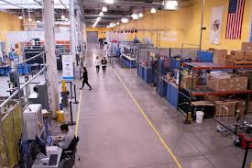
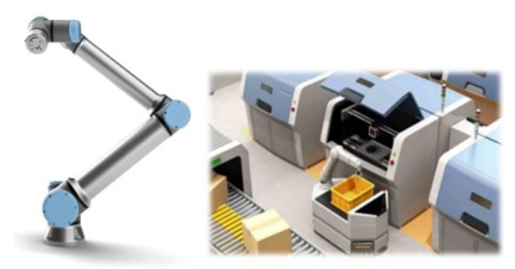
Project Summary
Problem statement:
Factory settings pose dangerous environments to human workers through the exposure to heavy machinery, tight spaces, and repetitive workloads. These hazards increase chance of injury and worker burnout. We need to implement collaborative robots (Cobots) to improve worker conditions.
Human Injury & Burnout in Warehouses
Cobot Solution
Notes:
Adrian

Slide 3
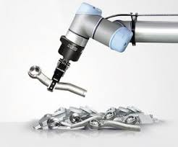
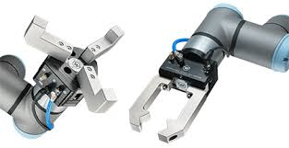
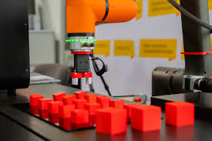
Project Summary
Solution proposal:
Develop a Cobot that can integrate into a factory environment to reduce human injury, worker burnout, and increase productivity in repetitive tasks. The Cobot shall be able to lift (1-2 lbs) and be placed into tight environments and controlled wirelessly through mobile app.
Repetitive Tasks
1-2 lbs. Load
Precise Control
Notes:
Ethan

Slide 4
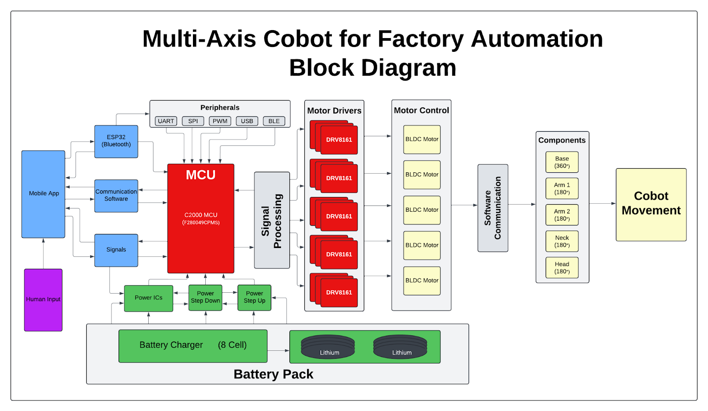
Project/Subsystem Overview
Adrian
Ethan
Jaishil
Emily
Subsystem Diagram Color: Power, MCU/Connectivity, Mobile App, Motor Control

Slide 5
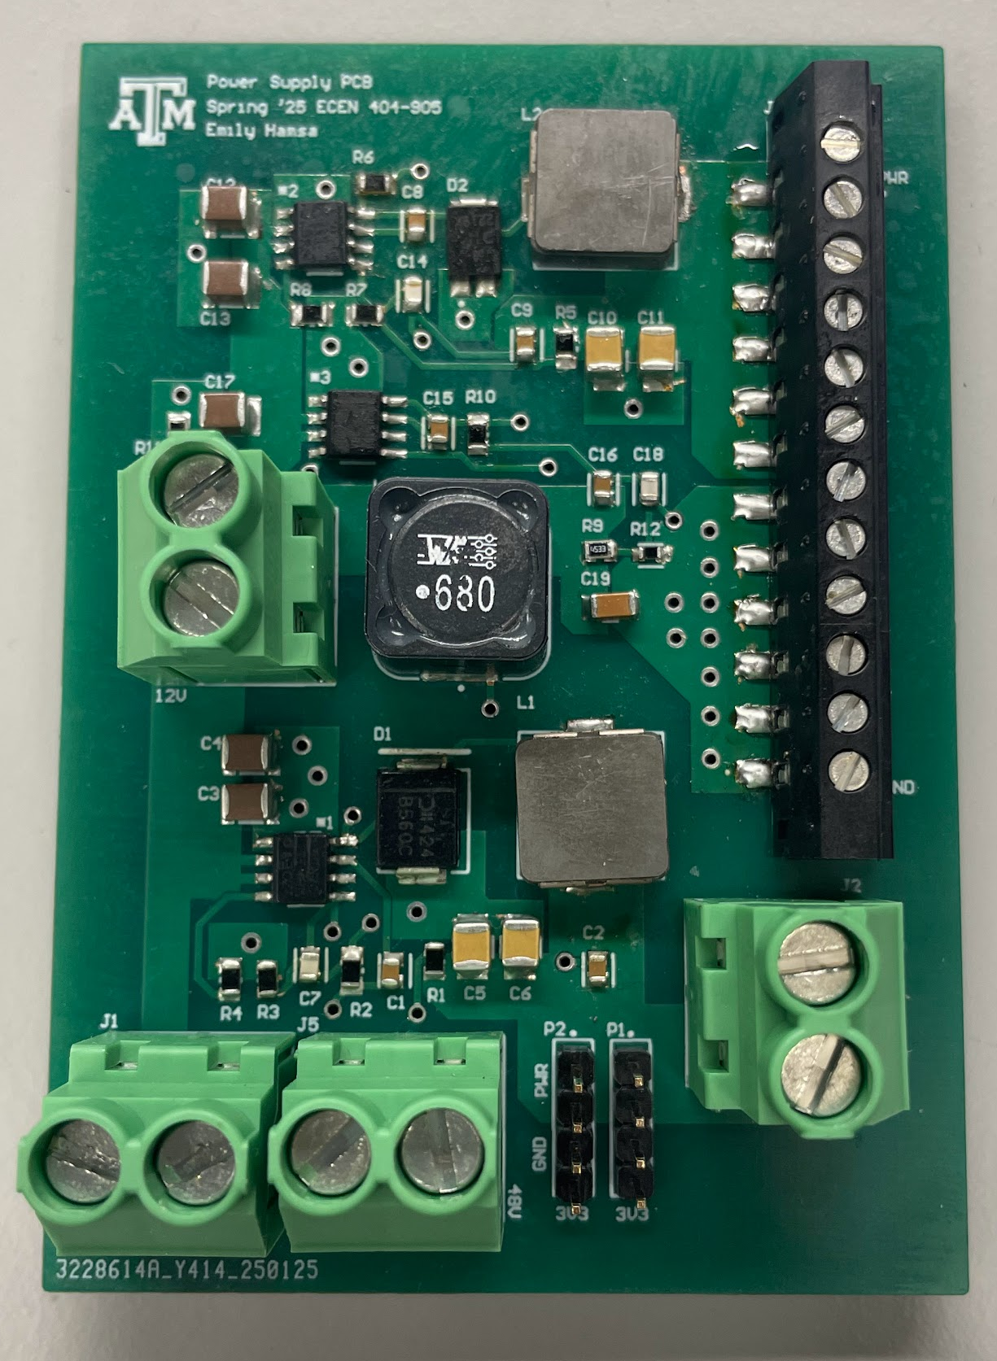
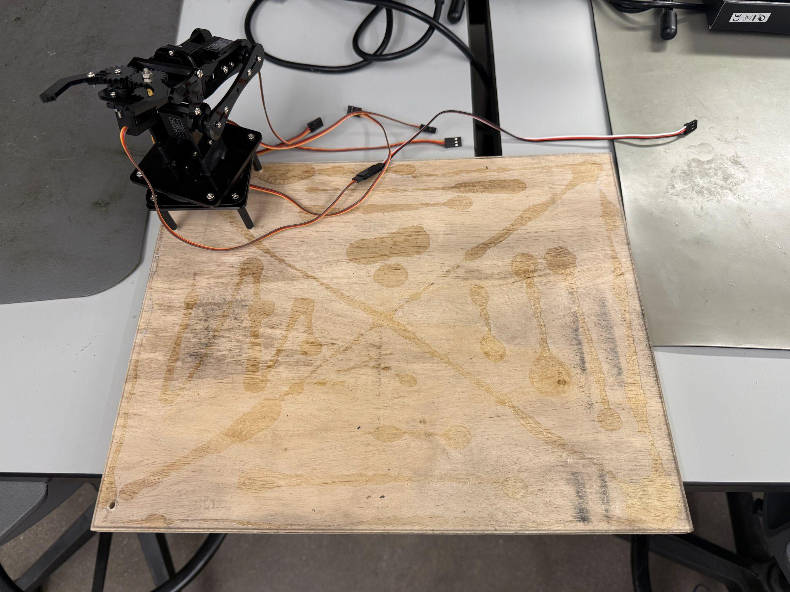
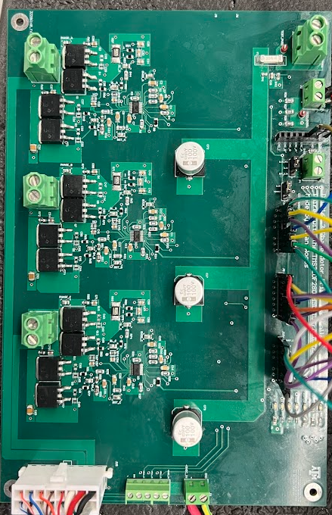
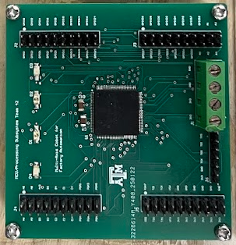
Integrated System Diagram (Before)
Power PCB
Platform
Motor Driver PCB
MCU PCB x2

Slide 6
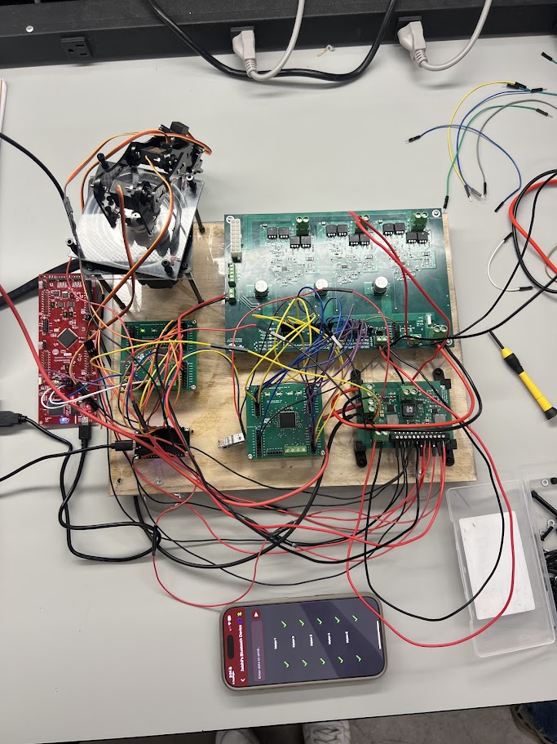
Integrated System Diagram (After)
Cobot Arm and Servo Motors
Motor Driver PCB
BLDC Motor
Power PCB
MCU PCB x2
Launchpad
Platform
ESP32
Mobile App

Slide 7
Project Timeline
Review/update progress since E403
Team finalizing design of new PCBs
Order PCB and components
Conversation over physical structure of cobot arm…(Amazon purchase with 1x BLDC motor and 3x-4x Servo)
Team is fixing issues with integration between subsystems
Reviewing bugs/fixing problems
Cobot arm should have clear path and deliverables
Team is fully integrated and operational
Cobot arm is moving
Fix issues with accuracy and movement of arm
Update #2 (Feb 3)
Update #4 (Mar 3)
Final #6 (Apr 7)
Update #1 (Jan 15)
Update #3 (Feb 17)
Update #5 (Mar 24)
Finish putting together new generation boards
Test and validate to ensure functionality
Cobot arm delivered and brainstorm ideas
Integration should be nearing completion
Cobot arm is revamped and near operation
Issues should be resolved with subsystems
Cobot arm is working as expected and can pick up objects that meet the restrictions
Team is making project look visually appealing
Cosmetic touch ups
Notes:
Required:
High level figure showing where you are at in the project, what’s completed, what’s underway – it should take about 30 seconds to summarize where you are in the timeline
-- Save discussion for subsystem update
-- Save detail for execution plan & validation plan status

Slide 8
Team Member 1
Ethan Woods
Accomplishments since last update 18 hrs of effort | Ongoing progress/problems and plans until the next presentation
Assembly of Cobot Created and assembled acrylic mounting plates to attach to the Motor Mounting Hub and Rotating Bearing Plate Assembly of Robotic Arm and BLDC Motor into Cobot. BLDC Motor Functionality BLDC Motor Board Operates with no faults BLDC Motor spins left and right using the mobile application to control direction Spins, but not consistent movement at around ~10% duty cycle. Post-Assembly Testing Helped to test the functionality of all motors with team after assembly of cobot arm | Encoder Implementation Implement Encoder into code for mobile application to allow for BLDC motor to operate within boundaries. Motor Movement On-going testing of best duty cycle % for smooth motor movement of the rotating bearing plate. Possibly need to re-grease the bearing as our first assembly was screwed on too tight Power and System Testing Some errors present when routing power between the Motor Driver PCB and Power Supply PCB Wire management and clean-up of our current design
Notes:
For 5th review Accomplishments should include system testing and specific validation scenarios results:
“Validated correct system operation for temperatures from 25C to 50C”
“Completed battery lifetime system test for maximum workload and simple workload cases”
“Validated back end database loss and recovery”
“Tested image detection in flight Pi-4 on drone with detection accuracy of XX”
“Validated all app error handling for valve failures”
“ON-GOING 5 day field test of monitoring system”
“Developing validation scenarios for mobile user operating through App and dispatcher functions through web app interface”

Slide 9
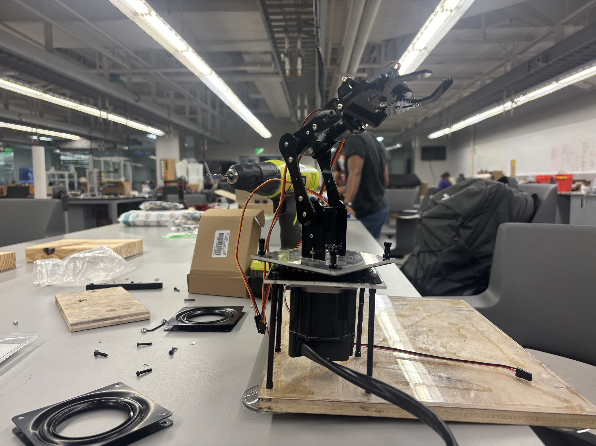
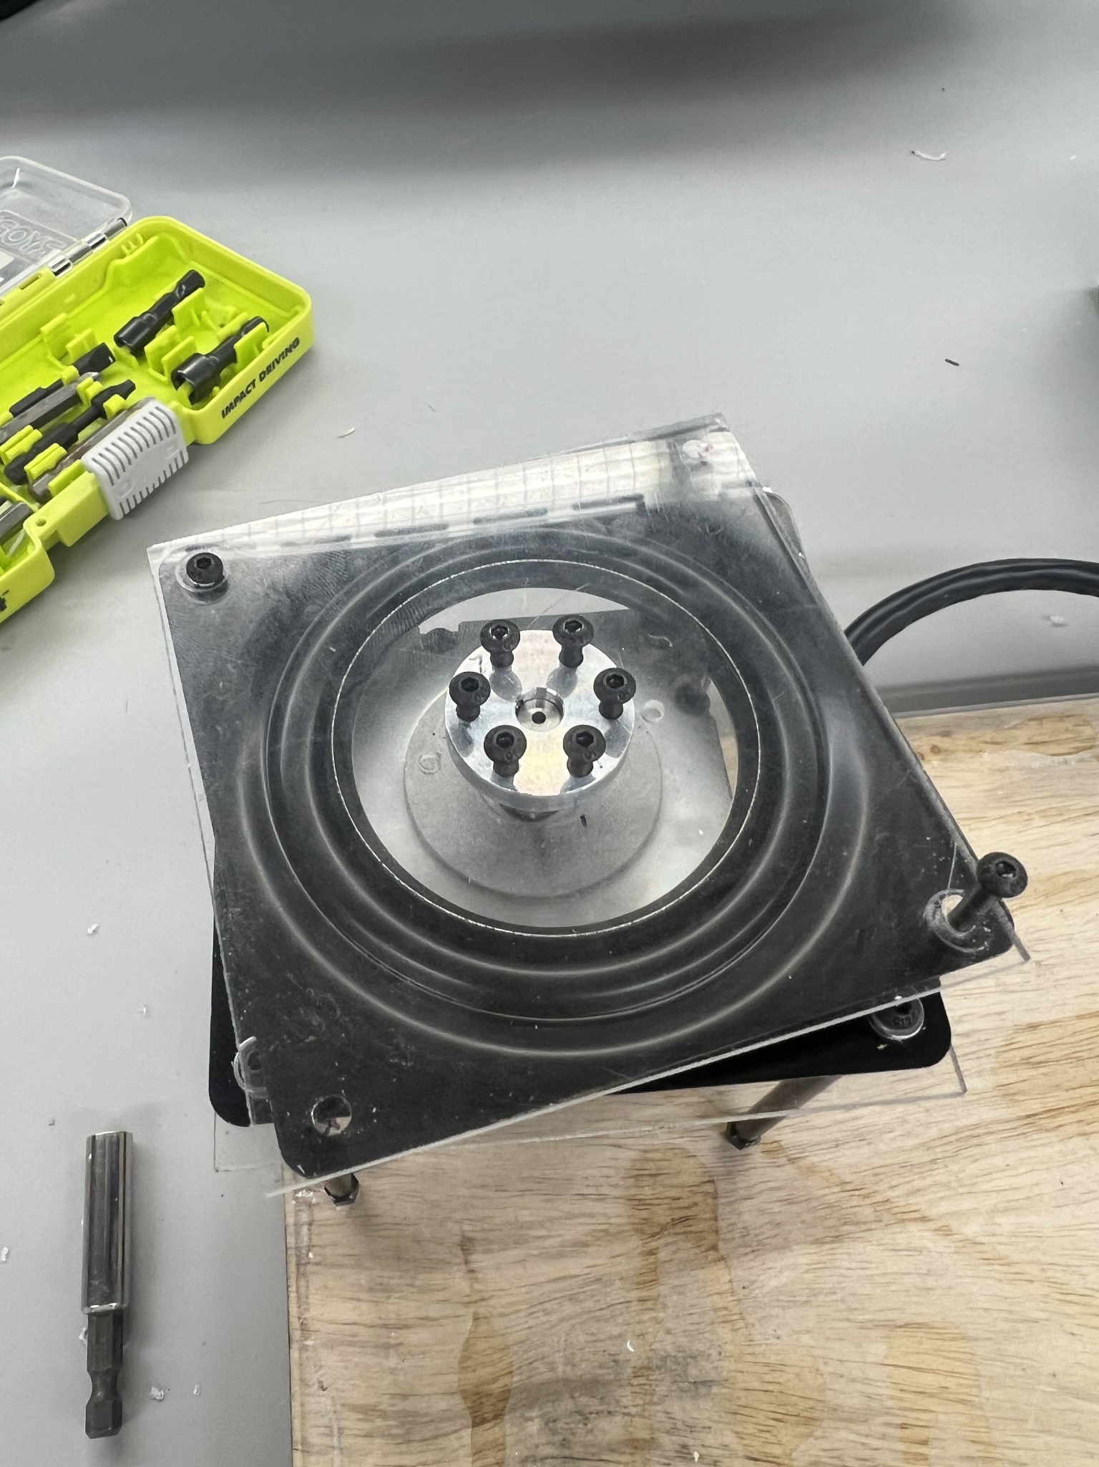
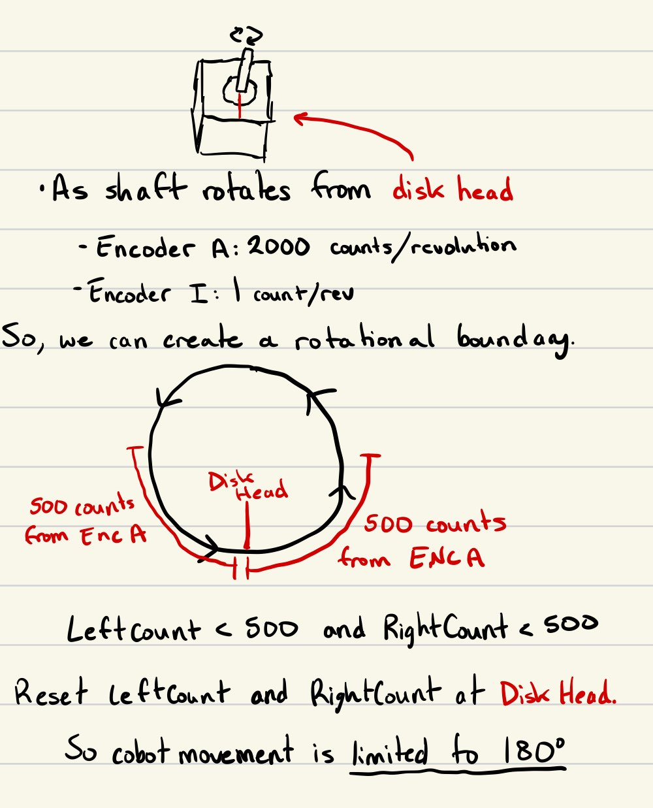
Team Member 1
Ethan Woods
Custom Attachment to Mounting Hub
Cobot Assembly Without PCBs
Encoder not yet implemented due to assembly, but implementation will be as follows:
Encoder Breakdown
Encoder will limit BLDC movement to 90° in both right and left directions.
The mobile app will stop sending movement signals once the motor has reached its threshold of distance.
It should be able to track back and forth movement and not stop if not past the threshold.
To know the cobot has re-centered (facing front), ENC I will move high, thus setting both right and left counts back to 0 (starting point).
D
B
A
Includes:
1x Rotating Bearing Plate (A)
2x Custom Cut Acrylic Sheets (B and C)
1x Universal Motor Mounting Hub (D)
C
BLDC Motor
Functionality: Shown in later slides!!
Notes:
This should all be test and validation results! – show things working, functional test results, error checking, etc, what validation is planned using what scenarios
Show test and validation results for integrated systems

Slide 10
Team Member 2
Adrian Guzman
Accomplishments since last update 20 hrs of effort | Ongoing progress/problems and plans until the next presentation
Assembly of Cobot Put together arm & BLDC motor on platform Drilled and mounted PCBs MCU functionality Successfully flashed 2x MCU boards Working Servo & BLDC programs Wireless controllability functional | Cobot Operation Demos for cobot to perform in operable range (ex. pick up block and move) Wire management and cleaning project display MCU Specific Look into flashing into flash instead of ram so program becomes static Mount launchpads on platform for easy programmability to main MCU PCBs
Notes:
For 5th review Accomplishments should include system testing and specific validation scenarios results:
“Validated correct system operation for temperatures from 25C to 50C”
“Completed battery lifetime system test for maximum workload and simple workload cases”
“Validated back end database loss and recovery”
“Tested image detection in flight Pi-4 on drone with detection accuracy of XX”
“Validated all app error handling for valve failures”
“ON-GOING 5 day field test of monitoring system”
“Developing validation scenarios for mobile user operating through App and dispatcher functions through web app interface”

Slide 11
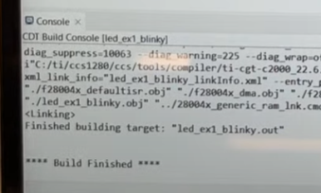
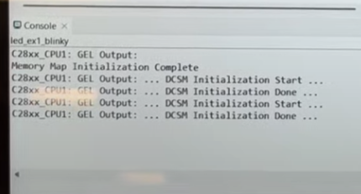
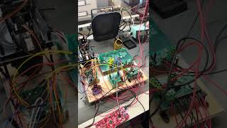
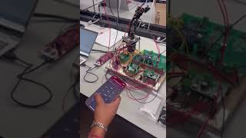
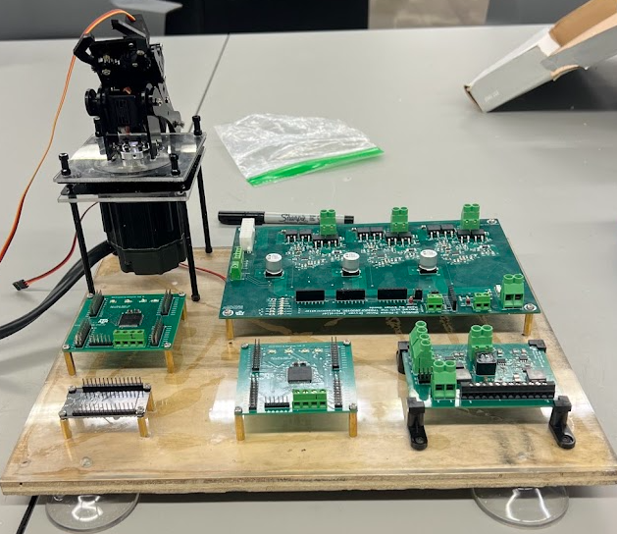
Team Member 2
Adrian Guzman
BLDC Motor Movement
BLDC Motor is moving through the wireless app
Not as fine as we would like, may need to increase duty cycle when trying to move right (bearings causing friction)
Will look into testing with buttons to remove ESP-32 delay during testing
Build & Compile Successful
Launchpad flashes programs to the 2 MCU boards
Issue programming using 3.3v from power board but sometimes it works
Can uses launchpad 3.3v supply to combat this issue
Platform Build
Helped with cobot assembly
Screwed PCBs into place
Robot Arm Functionality
Arm controlled through bluetooth app
Signal sent to ESP-32, then sent to C2000, then sent to respective Servo Motor
Notes:
This should all be test and validation results! – show things working, functional test results, error checking, etc, what validation is planned using what scenarios
Show test and validation results for integrated systems

Slide 12
Power Supply Subsystem
Emily Hamsa
This should not be just subsystem status!
It should be review of the System Test and Validation activities led by Team Member 1
Accomplishments since last update 15 hrs of effort | Ongoing progress/problems and plans until the next presentation
Tested power connection to MCU, Servos, BLDC and Motor Drivers, and ESP32 12V output is unstable 3V3 output delivering 3V3 but MCU is unable to flash when powered with power supply PCB All other connections were successful | Prepare battery Charge and drain a few times, find external fuse Debug 12V output Check quality of components and ensure they can handle this application Explore 3V3 powering MCU issues
For 5th review Accomplishments should include system testing and specific validation scenarios results:
“Validated correct system operation for temperatures from 25C to 50C”
“Completed battery lifetime system test for maximum workload and simple workload cases”
“Validated back end database loss and recovery”
“Tested image detection in flight Pi-4 on drone with detection accuracy of XX”
“Validated all app error handling for valve failures”
“ON-GOING 5 day field test of monitoring system”
“Developing validation scenarios for mobile user operating through App and dispatcher functions through web app interface”

Slide 13
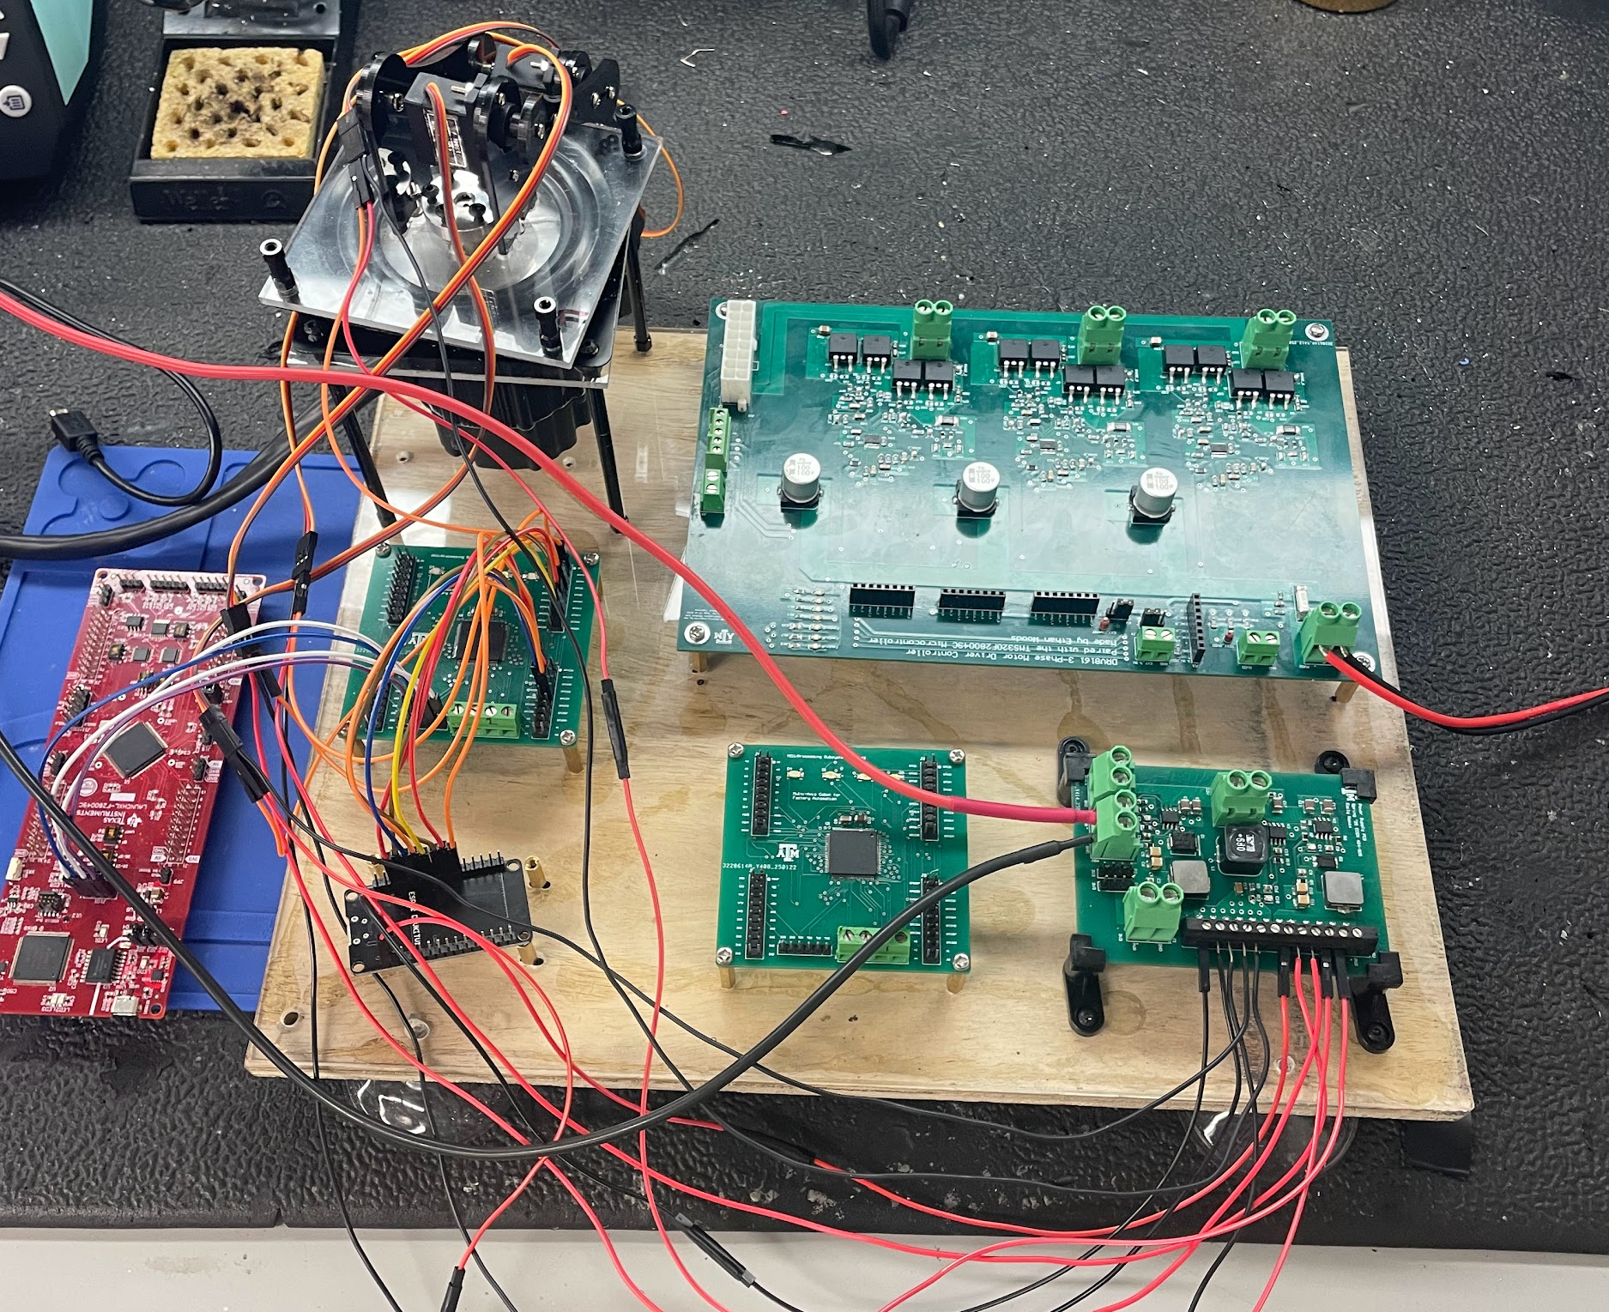
Power Supply Subsystem
Emily Hamsa
Power Supply PCB
Success in 3V3, 5V, and 48V
12V output has issues
When there is no load, the circuit outputs 12V as expected
When load is present, measurements present as a short, where the current increases to the power supply’s current limit and the voltage dips
When connecting 12V terminal on motor driver board, there is continuity between 12V and 48V terminals and ground
This should all be test and validation results! – show things working, functional test results, error checking, etc, what validation is planned using what scenarios
Show test and validation results for integrated systems

Slide 14
UI/Wireless Connectivity Subsystem
Jaishil Shah
Accomplishments since last update 20 hrs of effort | Ongoing progress/problems and plans until the next presentation
Validated Wireless Cobot movement (servo & bldc) Assembly of cobot (physical design & wiring) Successful integration of all four subsystems All intended outputs are achieved with stability/performance | Create test cases for project demonstration Add any final changes to mobile application 3D print small parts (motor base & wire encasings) Troubleshoot power difficulties with group members

Slide 15
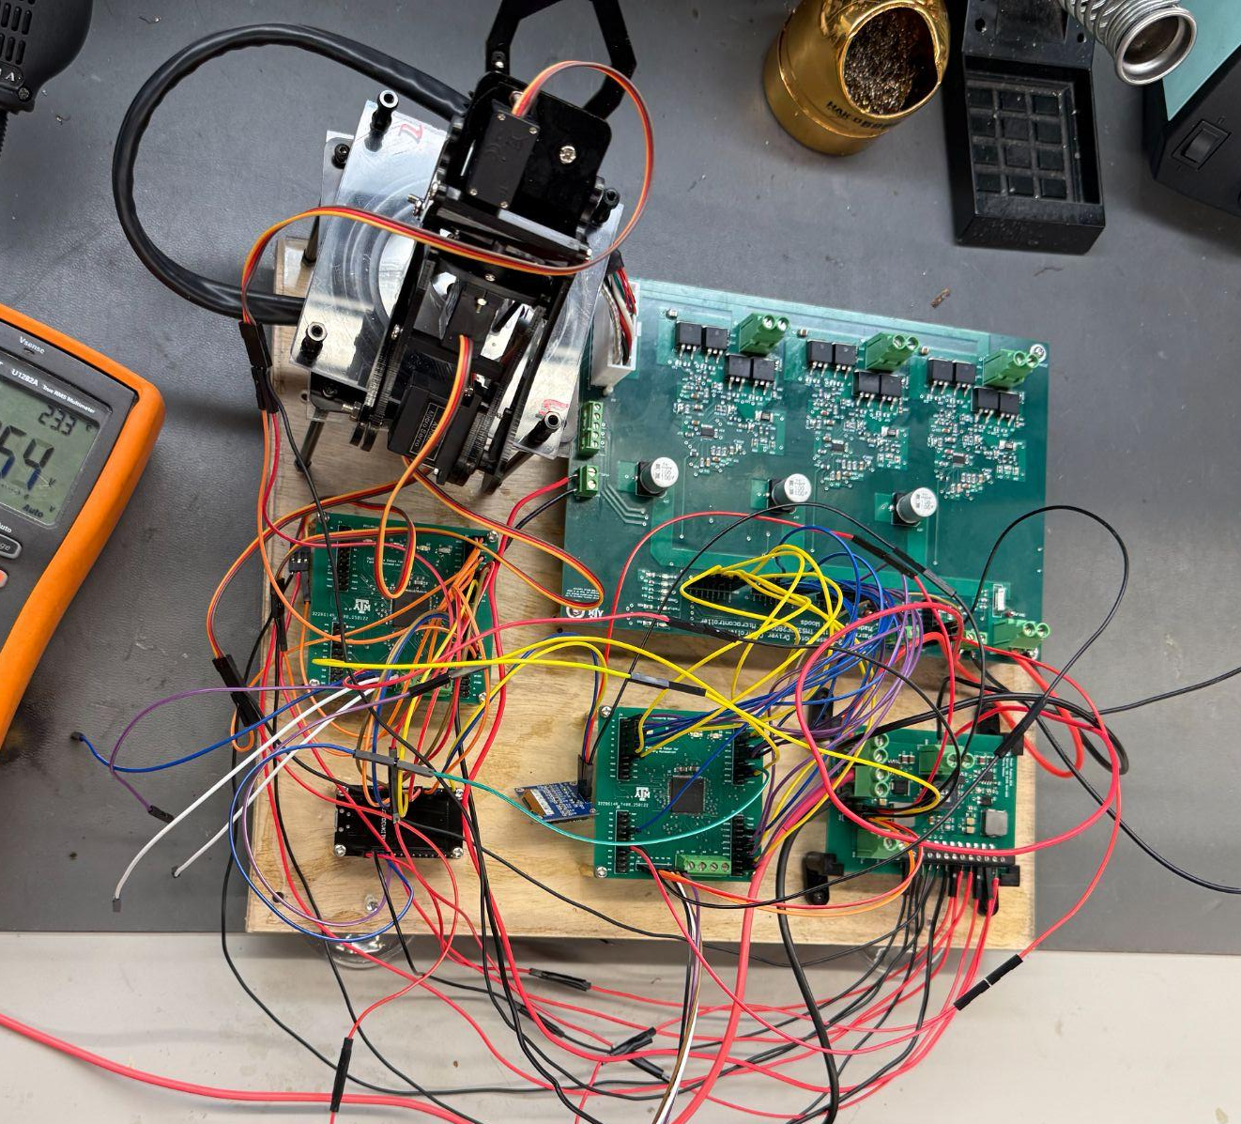

UI/Wireless Connectivity Subsystem
Jaishil Shah
ESP-32 → 2 MCU Boards
1 for Servo / 1 for BLDC
Full assembly of Cobot Arm
90 mm standoffs
bldc motor
bottom acrylic board
bearing
top acrylic board
motor shaft hub
cobot arms & servos

Slide 16
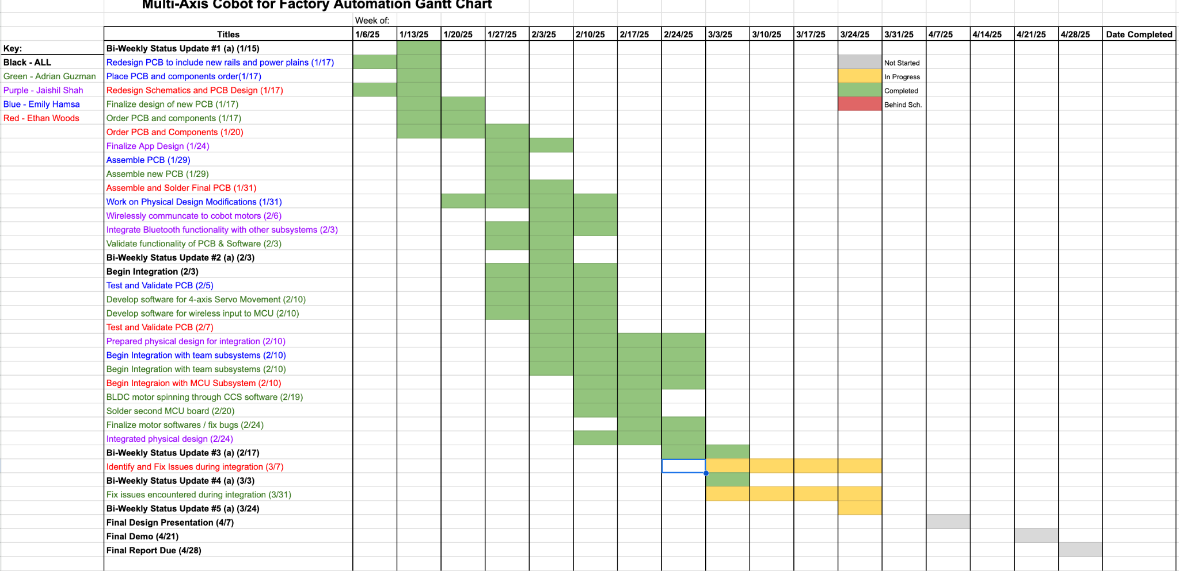
Execution Plan
Notes:
Michelle

Slide 17
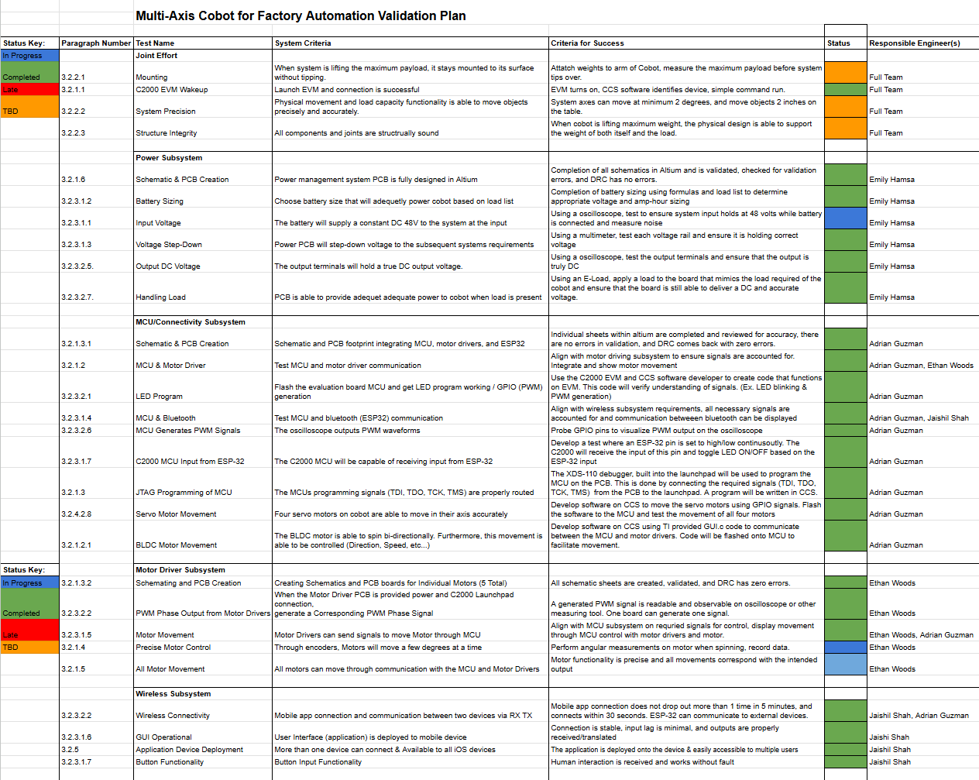
Validation Plan
Validation plan
This is not a gantt chart.
Validation plan is a table showing:
Name: descriptive short description of what is being validated,
Requirement: Identifer to link to requirement # from conops/fsr/icd
Success Criteria for validation – range/lifetime/performance metric/physical limit…that must be met.
Methodology – test procedure followed/observations made/simulations completed/.. to satisfy the validation
Responsible party
Status – complete/not complete
Notes:
Michelle

Slide 18
Final slide – thank your audience

